Slide 1
TERM 4

Slide 2
Contemporary Technology
Organ & Tissue Donation
IVF
Stem Cells
Genetically Modified Food

Slide 3
Consumer health
ethical issues arising from contemporary health practices
organ and tissue donation
in-vitro fertilisation
stem cells
genetically modified foods

Slide 4
Why are we investigating CT’s?
Technology develops quickly, and it has opened up many opportunities for improved health.
As most contemporary technologies include going “against nature” and “manipulating natural design” there are many ethical arguments that we need to consider.

Slide 5
Reminder: What are “Ethics” ???
ETHICS: Moral principles that govern a persons behaviours or the conducting of an activity.

Slide 6
4 Contemporary Technologies
Organ and Tissue Donation
In-Vitro Fertilization (IVF) https://www.youtube.com/watch?v=Z0dq4qm0AtQ
https://www.youtube.com/watch?v=az3KSFZ73gw
Stem Cell Research https://www.youtube.com/watch?v=nGg31Foz35Y
Genetically Modified Foods (GM) https://www.youtube.com/watch?v=xTqmTx26DhE
http://www.billsorganics.com.au/news/10-most-common-gmo-foods

Slide 7
CT 1: Organ and Tissue Donation
What are some common organs that are transplanted?
Kidneys, lungs, livers, heart, pancreas, intestines, stomach,
What body tissues are commonly transplanted?
Blood, plasma, skin, blood vessels, eye tissues (eg. Cornea), bone grafts, heart tissue.
https://www.youtube.com/watch?v=A8vi4GoImcU – Myths of Organ donation 3:23

Slide 8
Insight 50 mins

Slide 9
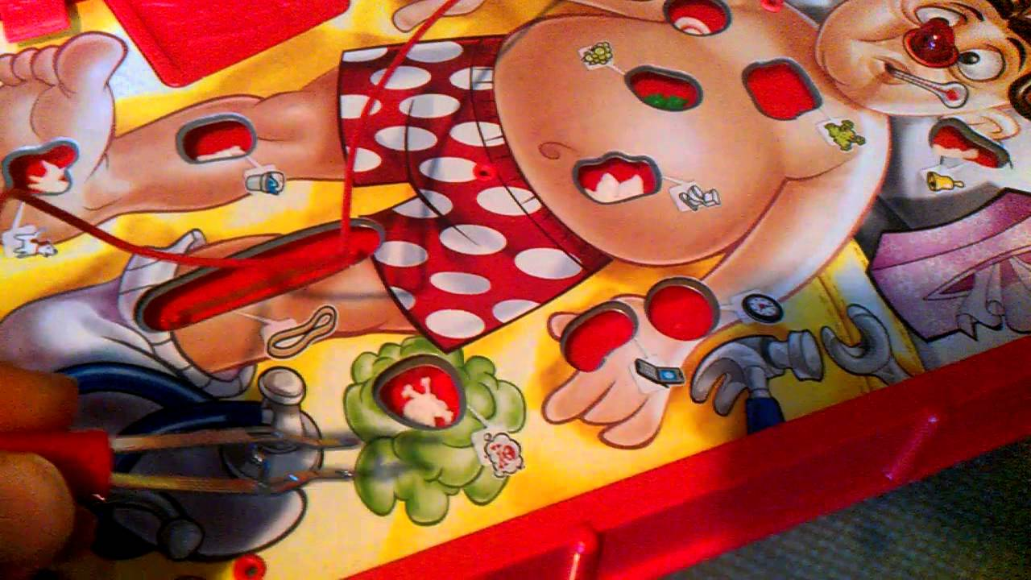
What does Organ Donation look like in Australia?
Australia is well known for its good reputation in successful organ transplant operations.
A donor’s family is asked to confirm the donors decision prior to undergoing removal procedures.
There are governing factors regarding where/how a person dies and the organ condition to qualify for donation.
The FACTS https://donatelife.gov.au/about-donation/get-facts/facts-and-statistics

Slide 10
Terminology
Person donating: DONOR
Person receiving: RECIPIENT
“Organ and tissue donation involves removing organs and tissues from someone who has died (a donor) and transplanting them into someone who, in many cases, is very ill or dying (a recipient)” -donatelife.gov.au

Slide 11
Brain Death
In Australia, “BRAIN DEATH” is determined by complete cease of blood flow to the brain, including the brainstem.
Occurs when an injury is sustained that increases the pressure in the brain which cuts off the blood supply.
There is no recovery.
When is brain death not required for donation?

Slide 12
Ethical Issues…
If an individual self inflicts the destruction of an organ (eg. Alcohol abuse leading to liver disease) do they deserve to get a new liver?
What do you think??
Would the liver be better off given to someone who needed it because of a condition like hemochromatosis?
Who gets priority for a new organ?

Slide 13
Allocation Policies
Determines who gets the next donor organ.
Based on factors such as:
Severity of disease
Likelihood of recovery
Size of the patient
Blood group
Age
https://www.nhmrc.gov.au/sites/default/files/images/nhmrc-ethical-guidelines-organ-transplant.pdf
http://www.tsanz.com.au/organallocationguidelines/index.asp Australian guidlines

Slide 14
Suggestion…
Recipients must refrain from drinking alcohol to be considered high on the allotment policy for a liver transplant.
Do you agree or disagree?
How does this fit with “Freedom of choice” and Human Rights?

Slide 15
The ethical debate…
Should there be lifestyle conditions in place for people who are recipients of organ donation?
Do other medical procedures have such conditions?
Is that fair?

Slide 16
Find an example of how a cultural belief could influence someone when making a decision about organ donation?

Slide 17
CT 2: In-Vitro Fertilisation (IVF)
Method of Assisted reproduction
Sperm and Egg are combined and fertilised in a petri dish/test tube (outside of the body)
Embryos are formed and transferred to woman’s uterus for implantation.
(Hopefully) will grow into a mature foetus.
THIS IS NOT A SIMPLE PROCESS, and not cheap.
https://www.ivf.com.au/fertility-treatment/ivf-treatment

Slide 18
IVF Procedure Steps
Stimulate the ovaries
Collecting the eggs
Fertilisation
Embryo transfer

Slide 19
Uses for IVF
Couples who can’t conceive naturally
Donor match for a sibling
To have a baby without a genetic condition that runs in the family.

Slide 20
Ethical Considerations of IVF
Are we “Playing God” by artificially creating life?
Is it up to scientists to determine who should be a parent and who shouldn’t be?
Sperm and Egg anonymous donation issues
Use and payment of surrogacy
The selection process for embryos (ie. Gender)
The use of frozen eggs/sperm from a deceased person
When does “life” actually begin?
OHSS
https://www.youtube.com/watch?v=d0IgU0hzVsc

Slide 21
Ethical Questions to Consider… Spend 15 mins researching these and report back!
1. Defining initiation of life ethically:
What happens to all those extra embryos?
The IVF process usually produces more embryo's than are actually implanted.
Is it ethical to destroy the unused embryos?
Is this considered abortion?

Slide 22
2. Turning children into commodities:
IVF turns conception and child-bearing into a commodity to be “bought and sold”
When a couple is infertile, do they have the right to sidestep the natural process of generation?
Do IVF clinics have the right to “sell” this procedure when all the genetic material is provided by the customers/couple?
Should IVF clinics make a profit? Should the procedure be government funded?

Slide 23
3. Should IVF be offered to older women?
Can older women cope with motherhood?
What will be the potential impact on the child’s health?
IVF is rarely successful in older women-so is it worth taking the risk?
Should there be an age limit? (there is an age limit for adoption…should it be the same?

Slide 24
Netflix
Explained – Designer DNA
David Attenborough – My witness statement

Slide 25
My Sisters Keeper
“Anna Fitzgerald looks to earn medical emancipation from her parents who until now have relied on their youngest child to help their leukemia-stricken daughter Kate remain alive.”

Slide 26
CT 3: Stem Cells
What are stem cells?
Undifferentiated cells that become differentiated into any kind of cells in the body. Often used by the body to replace old cells when they wear out and die.
Where are they found?
Early embryo, the fetus, placenta, umbilical cord and some other tissues on the adult body. (more on this later)

Slide 27
Scientists believe:
stem cells could help change how patients are treated by modern medicine.
Stem cells may help develop a better understanding of WHY some problems occur. (increase likelihood of finding effective treatment)
Stem cells could potentially create more individualised treatments that use the bodies own abilities to repair itself (and create its own new tissue and maybe organs!!)

Slide 28
Two Groups of Stem Cells
Tissue-Specific Stem Cells
Pluripotent Stem Cells
https://www.youtube.com/watch?v=9db44fBrWrE

Slide 29
Tissue-Specific Stem Cells
AKA “Somatic cells” or “adult stem cells”
THEORETICALLY they can divide without limit to replenish damaged or diseased cells.
Eg. In the base of your intestine there are stem cells that replace the cells that are worn off by digestion/food passing.
Eg. Bone marrow has similar cells (to produce red blood cells) and skin!!

Slide 30
Pluripotent Stem Cells
Can become any type of tissue in the body
Can keep dividing forever without losing their dividing potential!!
Have many more uses in medicine because they can be used as any type of cell.

Slide 31
Stem Cell treatment for Leukemia:
Leukemia is cancer that affects the cells in your bone marrow.
Doctors ALREADY use Tissue-Specific Stem Cells as a treatment option.
“Stem Cell Transplant” is the process of replacing blood forming cells (stem cells) that have been damaged by chemotherapy/radiotherapy.
READ PAGE 148 textbook
“ Tissue-Specific stem cells treat leukemia”

Slide 32
Ethical Issues involving Stem Cells
The harvesting of stem cells requires the use of fertilised embryos.
There are 2 main conflicting morals:
The desire to protect human life
The desire to treat illness and reduce suffering.

Slide 33
The debate starts when we try to define the beginning of human life.
Does life begin with conception? (ie. Sperm entering the Egg) Or does life begin with implantation into the uterine wall?
Is an embryo a “person”?-they definitely have the potential to grow into one.
Is an embryo a “person” when it has no characteristics of a person because it is just a collection of cells?
Is using stem cells to treat a “real person” to improve their QOL?
Is the health and suffering of a person take precedence over the potential life?

Slide 34
New Developments
TV4Education – start at 7:25 (Catalyst LIDAR/Stem Cell Ethics)
Induced Pluripotent Stem Cells Ethics - research

Slide 35
CT 4: Genetically Modified Food
What are genes?
-Genes are found in almost all cells of the body, and they use chemical messages to instruct the cell to perform its functions and/or take on particular characteristics.
When you introduce a new gene what do you think will happen?
-the cell will perform new functions and take on new characteristics

Slide 36
What are GM Foods?
Animal or plants that have had new genes inserted into the existing genetic code.
What are some examples of Genetic Modifications in food products?
Frost resistance, increased resistance to pests, increased nutritional value, increased shelf life.

Slide 37
RESEARCH
Find some more examples of genetic modifications:

Slide 38
Is it Safe?
Australia has strict pre-market safety assessments by “Food Standards Australia New Zealand”
GM foods must be labelled as GM on their labels.

Slide 39
Benefits of GM Foods
We need inexpensive, safe, nutritious food to feed to worlds growing population.
Better quality foods
Inexpensive & nutritious food
Foods with greater shelf life
Medicinal benefits, ie edible vaccines
Crops that require less chemicals

Slide 40
Risks of GM Foods
New allergens could be created
Antibiotic or pesticide resistance may develop
Cross breeding or cross contamination
Biodiversity implications
May pose ethical, philosophical or religious problems

Slide 41
FACT SHEET/POSTER
Create a poster about one of the Contemporary Technologies we have covered in class. Include the following:
Advancements in technology
How it is useful
Risks/concerns associated

Slide 42
Open book essay
Are contemporary technologies making people healthier? Why or why not?
Structure:
Intro, main body paragraphs, conclusion
Argument! Justify your position
(minimum 1 page)

Slide 43
Sources
Lockhart, E. (2010). Health Studies Stage 2A-b. Madeley: Print Publishing.
Organ Donor Website:
www.organdonor.gov/about/donated.html

Slide 45
Self Management Skills
Emotional Intelligence

Slide 46
Syllabus content
Self-management skills
definition of and competencies for Emotional Intelligence
self-awareness
self-regulation
self-motivation
social awareness
social skills

Slide 47
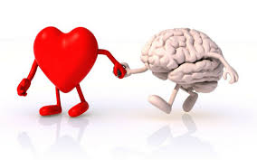
What is emotional intelligence? - https://www.youtube.com/watch?v=LgUCyWhJf6s
The ability of an individual to
recognize their emotions
understand what their emotions mean
Understand how their emotions affect the people around them
**Emotional Intelligence includes your PERCEPTION of others, and how you manage relationships.

Slide 48
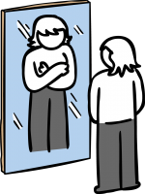
Self-awareness
Self-awareness is the ability to see yourself clearly and objectively through reflection and introspection.
Further reading - Positive psychology
Know the definition and use it to explain health benefits of good self-awareness or poor self- awareness.
Create 2 examples
This Photo by Unknown Author is licensed under CC BY-SA-NC

Slide 49
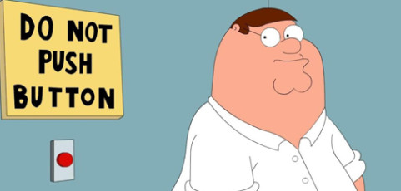
Self-regulation
Self-regulation is the ability to understand and manage your behaviour and your reactions to feelings and things happening around you.
Further reading – Raising Children
Know the definition and use it to explain health benefits of good self-regulation or poor self- regulation.
Create 2 examples
This Photo by Unknown Author is licensed under CC BY-NC-ND

Slide 50
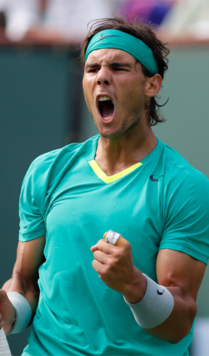
Self-motivation
“Self-motivation is, in its simplest form, the force that drives you to do things” (Skills You Need, n.d.).
Further reading – Positive Psychology
Know the definition and use it to explain health benefits of good self-motivation or poor self- motivation.
Create 2 examples
This Photo by Unknown Author is licensed under CC BY-SA-NC

Slide 51
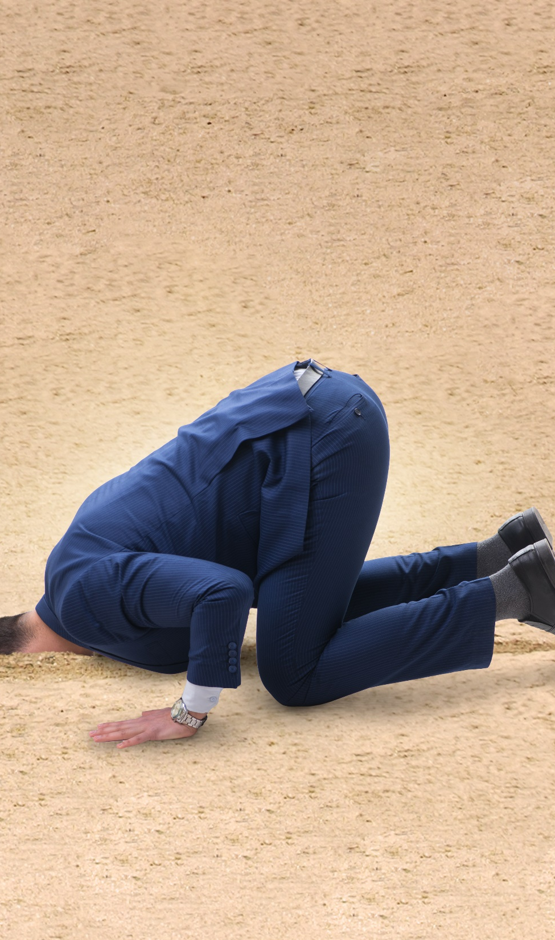
Social-awareness
Social awareness competencies involve being able to sense other people’s emotions, understanding their unique perspectives and learning to take an active interest in things they are concerned about.
Further reading – Social - awareness
Know the definition and use it to explain health benefits of good social-awareness or poor social-awareness.
Create 2 examples

Slide 52
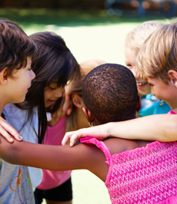
Social-skills
Social skills are the skills we use everyday to interact and communicate with others. They include verbal and non-verbal communication, such as speech, gesture, facial expression and body language
Further reading – Social skills
Know the definition and use it to explain health benefits of good social-skills or poor social-skills.
Create 2 examples

Slide 53
Why is Emotional Intelligence important?
}
Physical Health
Mental Well-Being
Relationships
Success
HEALTH IMPACTS

Slide 54
1. Physical Health
Emotional intelligence can influence our ability to take care of our bodies.
Impacts how we deal with stress.
When we are aware of our emotional state we can react appropriately to stressful situations and maintain good physical health

Slide 55
2. Mental Well-Being
Well developed emotional intelligence can improve our outlook on life.
Helps alleviate stress
Improves attitude
Helps avoid depression and mood swings
Direct correlation between highly developed emotional intelligence and mental wellness.

Slide 56
3. Relationships
Better social awareness and emotional intelligence equip individuals to build healthier relationships
WHY?
Individuals who can regulate their own emotions are better able to communicate their feelings and communicate in a more positive way. Better relation to others=better relationships!

Slide 57
4. Success
Increased emotional intelligence helps individuals to be self motivators! (this reduces procrastinations, increases self confidence and improves ability to focus on goals)
Also allows individuals to build better support networks, overcome setbacks, persevere through tough times and show resilience.

Slide 58
Poster
Include the 4 major health impacts with detail and examples for each onto a poster that could go onto the wall of a classroom.

Slide 59
Impact of Emotional Intelligence on Leadership:
RECAP:
“Leadership is a process of social influence which maximizes efforts of others towards achievement of a goal.”
-Kevin Kruse

Slide 60
Leadership
Better leaders understand what motivates others
Better leaders relate to others in a more positive way
Better leaders build stronger bonds with others
Better leaders recognize the needs of the team

Slide 61
Emotional Intelligence Competencies

Slide 62
5 Emotional Intelligence Competencies
Self awareness
Self regulation
Self motivation
Social awareness
Social skills
Lets look at each of these individually:

Slide 63
Self Awareness
“An individuals conscious knowledge of their own character, feelings, motives and desires.”

Slide 64
Self Awareness
Emotional awareness→ recognizing ones own emotions and their effects
Accurate self assessment → knowing ones strengths and limits
Self Confidence → sureness about ones self worth and capabilities
Example application – How does this help you at work/school/with friends?
Benefits of high/excellent self awareness
Negatives of low self awareness
Daniel Goleman
https://positivepsychology.com/self-awareness-matters-how-you-can-be-more-self-aware/

Slide 65
Self Regulation
“The ability to monitor and control our own behaviour, emotions, or thoughts, altering them in accordance with the demands of the situation.”

Slide 66
Self Regulation
Self control→ managing disruptive emotions and impulses
Trustworthiness → Maintaining standards of integrity and honesty
Conscientiousness → tasking responsibility for personal performance
Adaptability → flexibility in handling change
Innovativeness → Being open to new ideas and information
Example application – How does this help you at work/school/with friends?
Benefits of high/excellent self regulation
Negatives of low self regulation
Must read
http://www.danielgoleman.info/daniel-goleman-self-regulation-a-star-leaders-secret-weapon/

Slide 67
Self Motivation
“The ability to satisfy a desire, expectation, or goal without being influenced to do so by another person.”

Slide 68
Self Motivation
Achievement drive → striving to improve or meet a high standard
Commitment → aligning personal goals with the goals of the organization/company
Initiative → being ready to act upon opportunities
Optimism → persistence in pursuing goals despite setbacks
Intrinsic motivation vs extrinsic - What is best?
Example application – How does this help you at work/school/with friends?
Benefits of high/excellent self motivation
Negatives of low self motivation
2 mins Daniel Goleman https://www.youtube.com/watch?v=269QmB1-jyQ

Slide 69
Social Awareness
“The ability to effectively handle relationships; having awareness of others’ feelings, needs, and concerns.”

Slide 70
Social Awareness
Empathy → sensing others feelings/perspective and taking an active interest in their concerns
Service orientation →anticipating, recognizing and meeting customers needs
Developing others → sensing what others need in order to develop and helping them to develop these skills
Leveraging diversity →cultivating opportunities through diverse people
Political awareness → reading a groups emotional currents and power relationships
Example application – How does this help you at work/school/with friends?
Benefits of high/excellent social awareness
Negatives of low social awareness
http://www.danielgoleman.info/daniel-goleman-how-emotionally-intelligent-are-you/

Slide 71
Social Skills
“The skills that allow a person to interact and to act appropriately in given social contexts. ”

Slide 72
Social Skills
Influence → tactics for persuasion
Communication →sending clear and convincing messages
Leadership → inspiring/guiding groups of people
Change catalyst → initiating or managing change
Conflict Management →negotiating and resolving disagreements
Building bonds → nurturing instrumental relationships
Collaboration and Cooperation → working with others towards shared goals
Team capabilities → group energy in pursuing group goals
https://www.youtube.com/watch?v=62oz0kDZnPE

Slide 73
Social Skills
Example application – How does this help you at work/school/with friends?
Benefits of high/excellent social skills
Negatives of low social skills

Slide 74
Social and Personal Competencies Table
 | PERSONAL COMPETENCIES | SOCIAL COMPETENCIES
WHAT I SEE | Self awareness | Social awareness
WHAT I DO | Self regulation Self motivation | Social skills

Slide 75
Sources
Anthony McKeown. Library and Information Management, 2010
Lockhart, E. (2010). Health Studies Stage 2A-b. Madeley: Print Publishing.
Child Development Principles and Perspectives, by J.L. Cook, G. Cook, 2009 edition, p. 352-355.
Keith A Shaw
http://php.ipsiconnect.org/CWTI/EI/DefSocialAwareness.html
http://psychologydictionary.org/social-skills/

Slide 76
SEMESTER TWO EXAM

